Slide 1


❖ Expression Trees (syntax trees)
§2 Binary Trees
+
〖Example〗 Given an infix expression:
A + B ∗ C / D
A
/
∗
D
☞ Constructing an Expression Tree
(from postfix expression)
B
C
〖Example〗 ( a + b ) * ( c * ( d + e ) ) =
a b + c d e + * *
a
+
+
b
*
c
c
d
*
e
+
T₂
T₂
a
a
+
b
b
c
T₁
d
*
+
e
T₁
T₁
a
b
c
d
+
e
T₁
T₂
T₂
d
e
8/16

Slide 2

§2 Binary Trees
❖ Threaded Binary Trees
Because I enjoy giving
you headaches ... Just kidding.
Okay, think of a full
binary tree with n nodes.
How many links are there?
Here comes
the typical question of mine:
Why do we need
threaded binary trees?
Any clue on how to
improve the situation?
We can replace
the null links by “threads”
which will make traversals
easier.
Then who should
take the credit?
They are
A. J. Perlis and C. Thornton.
You are such a
genius !
n + 1.
Oh well,
I wish I’d have really done it
Of course not!
How many of them
are NULL?
You got it!
Can I stand that?
14/16

Slide 3
§2 Binary Trees
Rule 1: If root->lcl is null, replace it with a pointer to the inorder predecessor of Tree.
Rule 2: If root->rcl is null, replace it with a pointer to the inorder successor of Tree.
Rule 3: There must not be any loose threads. Therefore a threaded binary tree must have a head node of which the left child points to the first node.
class ThreadedTreeNode {
int LeftThread; /* if it is TRUE, then Left */
ThreadedTree Left; /* is a thread, not a child ptr. */
ElementType Element;
int RightThread; /* if it is TRUE, then Right */
ThreadedTree Right; /* is a thread, not a child ptr. */
}
15/16

Slide 4
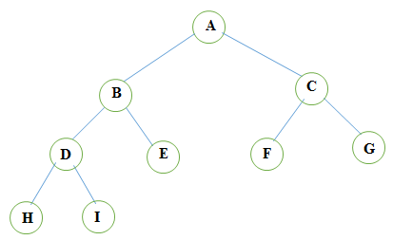
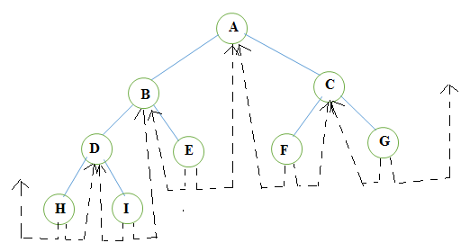

Slide 5
Assume that ptr is an arbitrary node in a threaded binary tree, then the following constraints hold:
If ptr->leftThread = TRUE or 1, then ptr->lcl contains thread.
If ptr->rightThread = TRUE or 1, then ptr->rcl contains thread.
Traditionally, root->rlink = root and root->rightThread = 0 for any threaded binary tree.
The root points to the header node of the tree, while root->llink points to the start of the first node of the actual tree.
The loose thread from the right most node and the left most node is handled by having them pointed to the header node.

Slide 6
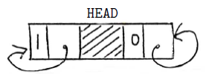
Empty Threaded BT

Slide 7
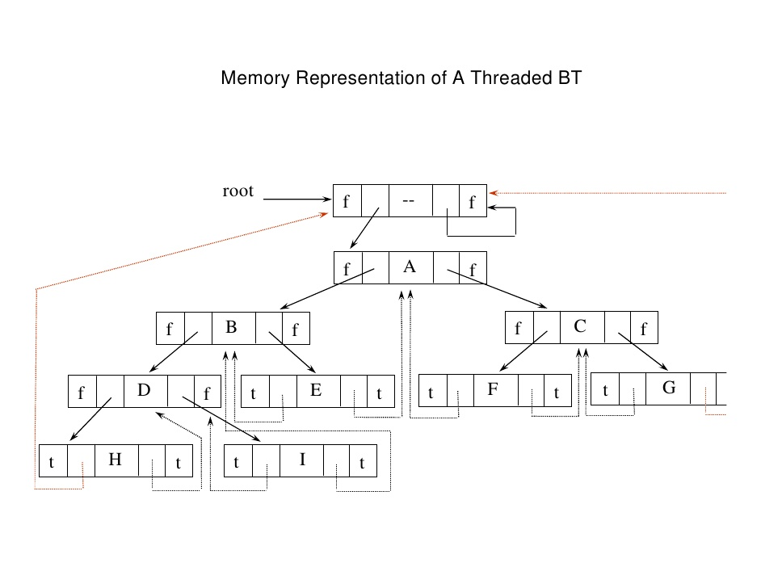

Slide 8
§2 Binary Trees
〖Example〗 Given the syntax tree of an expression (infix)
A + B ∗ C / D
head node
+
F
F
A
/
∗
D
F
+
F
B
C
T
A
T
F
/
F
F
∗
F
T
D
T
T
B
T
T
C
T
16/16

Slide 9
void tinorder(node *root)
{
node *temp=root;
for(;;)
{
temp=in_suc(temp);
if(temp==root)
break;
cout<<temp->info;
}
}
node *in_suc(node *root)
{
node *temp;
temp=root->rlink;
if(!root->rthread)
{
while(!temp->lthread)
temp=temp->llink;
}
return temp;
}

